Slide 1
COVID INFORMATION APP Group: Brainstromers Deliverable-1

Slide 2
Contents
Background
Motivation
Development Environment
Features
Research Design
Team Roles
Gantt Chart
Risk Management
Conclusion

Slide 3
BACKGROUND
An initial assumption placed China as the birthplace of the COVID-19 pandemic, however the virus has now been found on every continent.
On March 11th, 2020, the WHO announced that COVID-19 has spread across the globe.
Several countries have implemented stringent measures to limit the spread of sickness and alleviate stress on healthcare systems as a direct result of the impact the disease has had on international commerce, employment, and travel.
Until the COVID-19 virus has been eradicated, authorities in several countries have advised people to stay inside and minimize their contact with others.
For everyone, the current global coronavirus outbreak has been extremely challenging.
According to recent studies, the current epidemic has affected 213 nations, and some people fear that it may continue for a very long time.

Slide 4
Motivation
The creation of an Android app that spreads information about the current COVID-19 epidemic and helps individuals who have contracted it is described in this article.
Those working to stop the pandemic may better coordinate with the medical community and government officials by using the app.
The COVID-19 pandemic may be followed in real time, and viewers can look up information on probable symptoms, find hotspots on an interactive map, and learn ways to stop the spread of the illness.
These kind of smartphone applications are essential during the current epidemic since they facilitate communication between the government and the public and the distribution of help.
Regardless of whether mobile applications have a role in the treatment of chronic diseases, the current COVID-19 epidemic has emphasized the need for solutions that use mobile apps to reduce the likelihood of transmission through intimate contact.

Slide 5
Development Environment
IDE : Android studio,jdk
Front End Language : XML
Back End Language : Java

Slide 6
Features
Here, you may view state-by-state COVID data in real time. We've broken down the overall number of confirmed, suspected, and suspected instances of the virus by state for your convenience. The information was gathered from the accurate, real-time-updated COVID-19 website of the Indian government.
The importance of symptoms in app should be recalled. The users will have to fill out a health survey. An algorithm based on historical COVID behavior can evaluate a user's symptoms and offer an approximate estimate of the user's risk of contracting the virus.
The majority of app users will first utilize the search bar before selecting the "Map Check" option. Depending on how likely it is that they have come into contact with the virus, you may see a map below with red, orange, or green pins reflecting the locations of people who have reported symptoms to the app database. The color of the pin might be used to graphically represent a person's level of viral exposure. If you have been experiencing symptoms and have reported them, authorities may go through your data using Map Check.

Slide 7
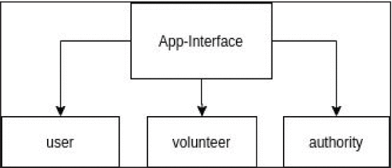
RESEARCH DESIGN

Slide 8
Team Roles
1.Vaishnavi Mandadi : Project management lead,Demo and presentation lead manages design of user interface.
2. Akshaya Sampelli : Implementation of Android frontend,System administrator lead and manages meeting minutes.
3.Venkata Sai Reshma Kallepalli : Demo and presentation lead ,Graphics designer and manages documentation.
4. Aishwarya Yadav Jala :Implementation of android backend, designing of user interface,testing and github.
5.Sahit Reddy Chinthakuntla : Requirements lead,Java developer and manages documentation.
6.Kiran Jyothi Bodduluri : Implementation of android backend and manages configuration and management.
7.Rajashekar Reddy Moddu : Configuration and management lead and creates meeting.

Slide 9
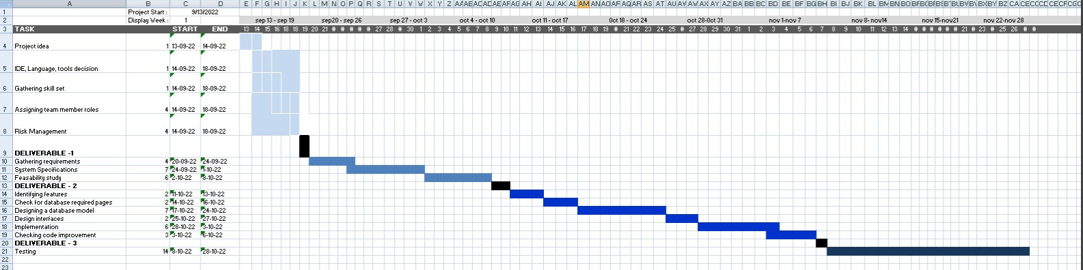
Gantt Chart

Slide 10
Risk Management
The process of identifying and mitigating potential risks is known as "risk management" in business contexts.
These risks could come from any division, including marketing, production, project management, human resources, and accounting.
In order to avoid doing irreversible damage to a firm, all risks, no matter how big or little or what they are, should be detected as soon as possible and mitigated, if at all feasible.
There are typically two types of risk factors: internal and external.
Internal risk factors can come from within a business and include various forms of fraud, contract breaches, attacks on network security, and inept management.
Unlike internal ones, external variables are not directly controlled by the organization. Changes in the stock market, interest rates, governmental initiatives, new legislation, and, most recently, the effects of the pandemic on society and the economy are a few examples.

Slide 11
Conclusion
For the time being, there is no vaccine available to prevent infection with COVID-19. If you care about your health, the best thing you can do is separate yourself from people who may be afflicted with the virus. There are some overlaps between this list and the one provided by Coronavirus, which includes comparable recommendations for common sense methods of protection.

Slide 12
THANKYOU

